Slide 1
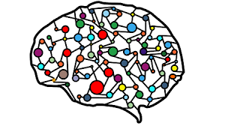
Spliceosome Deep Learning
Presented by:
Doaa Abd El-Hafez Gad
Eman Mohammed Essa Riad
Doaa Taha Mohamaden
Tasneem Mohammed Ibrahim
Alaa Mohammed Thabet Abdelsalam
Alaa Mohammed Abdelaal Amer
Alaa Atef Moubark Mohamed
Alaa Ayman Abd Elghany Mohamed
Dr: Ibrahim El-Semman

Slide 2

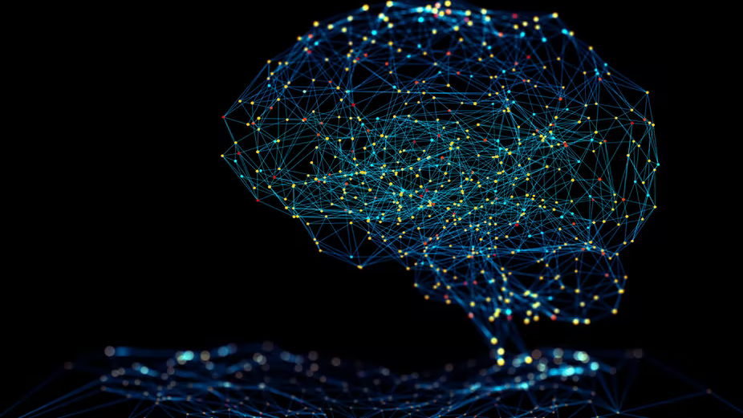
What is Neural Networks?

Slide 3

What is a biological neural network ?
biological neural network is a network of neurons that are
connected together by axons and dendrites.
The connections between neurons are made by synapses.
The axons transport chemicals that caused by
neurotransmitters to be released onto dendrites.
The neural network is able to learn and remember
information, allowing it to solve problems or make decisions.
What is biological neural network structure?
Biological Neural Network (BNN) structure consists of :
Synapse
dendrites
cell body
Axon
The human brain is composed of 86 billion nerve cells
called neurons.

Slide 4
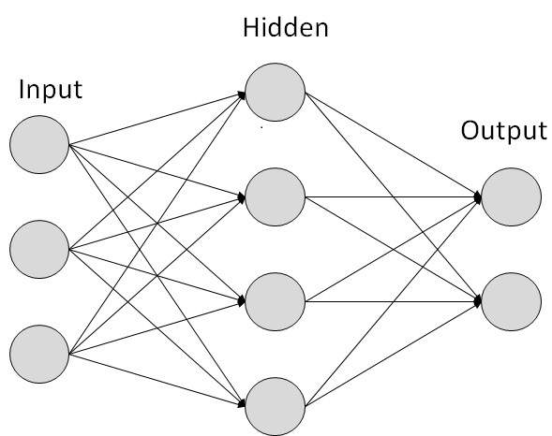
What is Artificial Neural Networks ?
neural networks (are known as artificial neural networks (ANNs) or simulated neural networks (SNNs) reflect the behavior of the human brain, allowing computer programs to recognize patterns and solve common problems in the fields of AI, machine learning, and deep learning.
ANNs are composed of multiple nodes, which imitate biological neurons of human brain.
The neurons are connected by links and they interact with each other.
The nodes can take input data and perform simple operations on the data.
The result of these operations is passed to other neurons.
The output of each node is input to other and called activation or node value.
Each link is associated with weight.
ANNs have appility to learning, which caused by change weight values.
What is Artificial Neural Networks structure ?
Input layer: The data that we feed to the model is loaded into the input
layer from external sources like a CSV file or a web service.
Hidden layer: is the intermediate layers that do all the computation and
extract the features from the data, can be one layer or more.
Output layer: takes input from hidden layers and comes to a final
prediction based on the model’s learnings.
It is the most important layer where we get the final result.

Slide 5
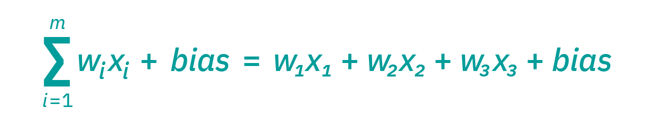
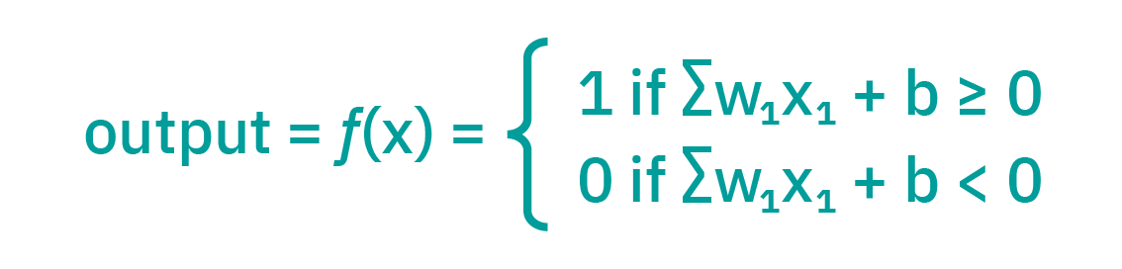
How Artificial Neural Networks Work?
Think of each node as its own linear regression model, composed of input data, weights, bias (or threshold), and an output. The formula would look like this:
The activation function is responsible for deciding whether a neuron should be activated or not.
Without the Activation function, the neural network behaves as a linear classifier.
the basic purpose of the activation function is to introduce non-linearity into the output of a neuron.

Slide 6
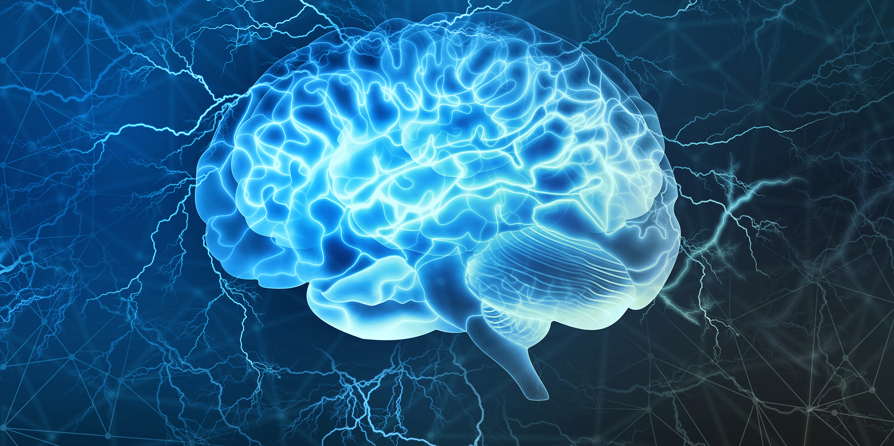
How NN works ?

Slide 7
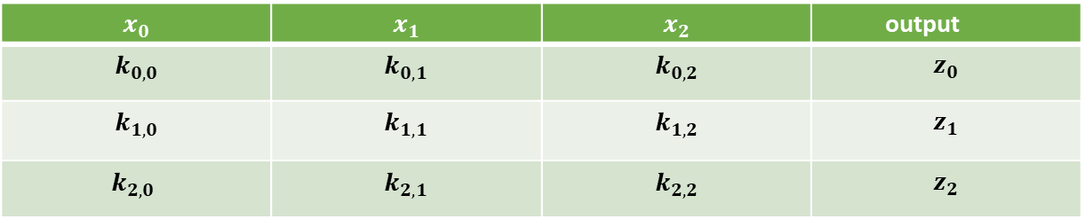
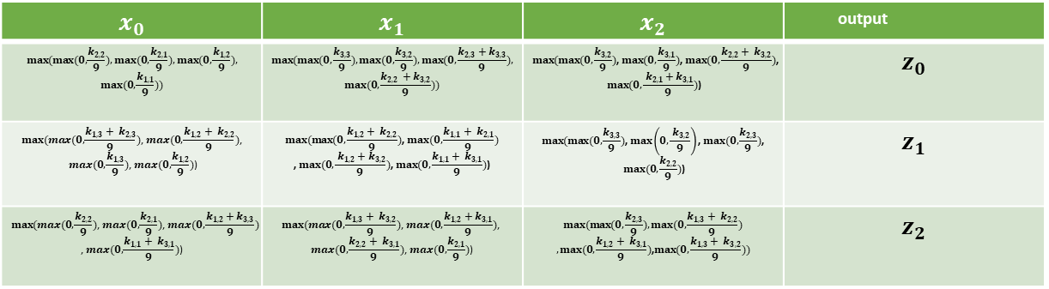
Input data
$$x_{0}$$ | $$x_{1}$$ | $$x_{2}$$ | output
$$max⁡(max(0,\frac{k_{2,2}}{9}),max(0,\frac{k_{2,1}}{9}),max(0,\frac{k_{1,2}}{9}),$$ $$max(0,\frac{k_{1,1}}{9}))$$ | $$max⁡(max(0,\frac{k_{3,3}}{9}),max(0,\frac{k_{3,2}}{9}),max(0,\frac{k_{2,3}+k_{3,3}}{9}),$$ $$max(0,\frac{k_{2,2 }+k_{3,2}}{9}))$$ | $$max(max(0,\frac{k_{3,2}}{9})\text{, }max(0,\frac{k_{3,1}}{9})\text{, }max(0,\frac{k_{2,2}+ k_{3,2}}{9})\text{,}$$ $$max(0,\frac{ k_{2,1}+k_{3,1}}{9})\text{)}$$ | $$z_{0}$$
$$max⁡(max(0,\frac{k_{1,3}+ k_{2,3}}{9})\text{, }max(0,\frac{k_{1,2}+ k_{2,2}}{9})\text{,}$$ $$max(0,\frac{k_{1,3}}{9})\text{, }max(0,\frac{k_{1,2}}{9})\text{)}$$ | $$max⁡(max(0,\frac{k_{1,2}+ k_{2,2}}{9})\text{, }max(0,\frac{k_{1,1}+ k_{2,1}}{9})$$ $$\text{, }max(0,\frac{ k_{1,2}+k_{3,2}}{9})\text{, }max(0,\frac{k_{1,1}+ k_{3,1}}{9})\text{)}$$ | $$max⁡(max(0,\frac{k_{3,3}}{9})\text{, }max\left(0,\frac{ k_{3,2}}{9}\right)\text{, }max(0,\frac{k_{2,3}}{9})\text{,}$$ $$max(0,\frac{k_{2,2}}{9})\text{)}$$ | $$z_{1}$$
$$max⁡(max(0,\frac{k_{2,2}}{9})\text{, }max(0,\frac{k_{2,1}}{9})\text{, }max(0,\frac{k_{1,2}+k_{3,3}}{9})$$ $$\text{, }max(0,\frac{k_{1,1}+ k_{3,1}}{9})\text{)}$$ | $$max⁡(max(0,\frac{k_{1,3}+ k_{3,2}}{9})\text{, }max(0,\frac{k_{1,2}+k_{3,1}}{9})\text{, }$$ $$max(0,\frac{k_{2,2}+ k_{3,1}}{9})\text{, }max(0,\frac{k_{2,1}}{9})\text{)}$$ | $$max⁡(max(0,\frac{k_{2,3}}{9}),max(0,\frac{k_{1,3}+ k_{2,2}}{9})$$ $$,max(0,\frac{k_{1,2}+ k_{3,1}}{9})\text{,}max(0,\frac{k_{1,3}+ k_{3,2}}{9}))$$ | $$z_{2}$$
=
$$x_{0}$$ | $$x_{1}$$ | $$x_{2}$$ | output
$$k_{0,0}$$ | $$k_{0,1}$$ | $$k_{0,2}$$ | $$z_{0}$$
$$k_{1,0}$$ | $$k_{1,1}$$ | $$k_{1,2}$$ | $$z_{1}$$
$$k_{2,0}$$ | $$k_{2,1}$$ | $$k_{2,2}$$ | $$z_{2}$$

Slide 8
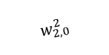
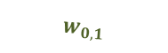
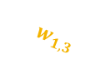
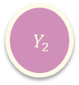


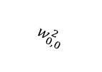
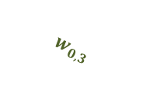
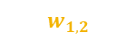
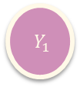



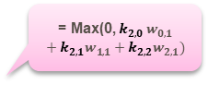
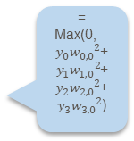
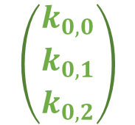

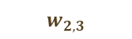
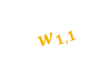
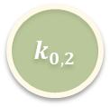
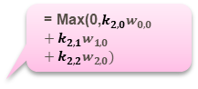
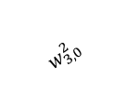
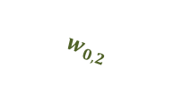
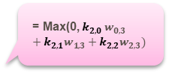
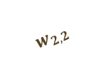
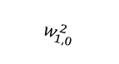
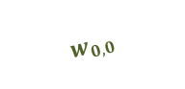
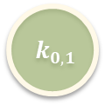
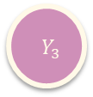
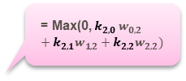
Hidden Layer
Input Layer
= Max(0,$k_{2,0}w_{0,0} +k_{2,1}w_{1,0}+k_{2,2}w_{2,0})$
Output Layer
$${ Y}_{0}$$
$$k_{0,0}$$
$$w_{0,0}$$
$$w_{0,1}$$
$$w_{0,2}$$
= Max(0, $k_{2,0} w_{0,1}+k_{2,1}w_{1,1}+k_{2,2}w_{2,1})$
$$w_{0,3}$$
$${ Y}_{1}$$
$$\left(\begin{aligned}k_{0,0} \\ k_{0,1} \\ k_{0,2}\end{aligned}\right)$$
$$w_{1,0}$$
$$w_{0,0}^{2}$$
= Max(0, $y_{0}{w_{0,0}}^{2}$+$y_{1}{w_{1,0}}^{2}$+$y_{2}{w_{2,0}}^{2}$+$y_{3}{w_{3,0}}^{2}$)
$$k_{0,1}$$
$$w_{1,1}$$
$$w_{1,0}^{2}$$
$${ Z}_{0}$$
$$w_{1,2}$$
$$w_{2,0}^{2}$$
$$w_{1,3}$$
= Max(0, $k_{2,0} w_{0,2}+k_{2,1}w_{1,2}+k_{2,2}w_{2,2})$
$$w_{3,0}^{2}$$
$$w_{2,0}$$
$${ Y}_{2}$$
$$w_{2,1}$$
$${ k}_{0,2}$$
$$w_{2,2}$$
$$w_{2,3}$$
= Max(0, $k_{2,0} w_{0,3}+k_{2,1}w_{1,3}+k_{2,2}w_{2,3})$
$${ Y}_{3}$$

Slide 9

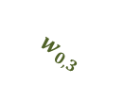

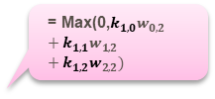

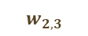
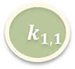

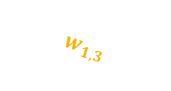
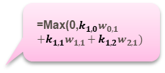
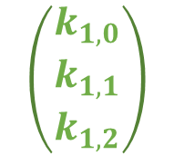
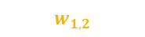
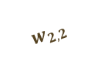
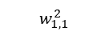


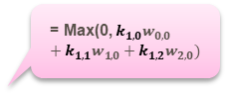
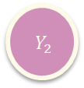
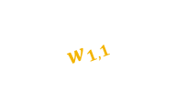
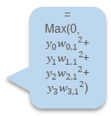
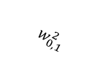
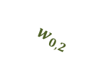

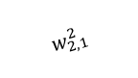
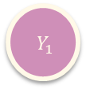





Hidden Layer
Input Layer
Output Layer
= Max(0, $k_{1,0}w_{0,0} +k_{1,1}w_{1,0}+k_{1,2}w_{2,0})$
$${ Y}_{0}$$
$$k_{1,0}$$
$$w_{0,0}$$
$$w_{0,1}$$
$$w_{0,2}$$
=Max(0,$k_{1,0}w_{0,1 }$
$$+k_{1,1}w_{1,1}+k_{1,2}w_{2,1})$$
$$w_{0,3}$$
= Max(0, $y_{0}{w_{0,1}}^{2}$+$y_{1}{w_{1,1}}^{2}$+$y_{2}{w_{2,1}}^{2}$+$y_{3}{w_{3,1}}^{2}$)
$${ Y}_{1}$$
$$w_{0,1}^{2}$$
$$\left(\begin{aligned}k_{1,0} \\ k_{1,1} \\ k_{1,2}\end{aligned}\right)$$
$$w_{1,0}$$
$$w_{1,1}^{2}$$
$${ Z}_{1}$$
$$k_{1,1}$$
$$w_{1,1}$$
$$w_{2,1}^{2}$$
$$w_{1,2}$$
$$w_{1,3}$$
$$w_{3,1}^{2}$$
= Max(0,$k_{1,0}w_{0,2} +k_{1,1}w_{1,2}+{k_{1,2}w}_{2,2})$
$$w_{2,0}$$
$${ Y}_{2}$$
$$w_{2,1}$$
$$w_{2,2}$$
$$k_{1,2}$$
$$w_{2,3}$$
= Max(0,$k_{1,0}w_{0,3} +k_{1,1}w_{1,3}+k_{1,2}w_{2,3})$
$${ Y}_{3}$$

Slide 10




















Hidden Layer
Input Layer
= Max(0,$k_{2,0}w_{0,0} +k_{2,1}w_{1,0}+k_{2,2}w_{2,0})$
Output Layer
$${ Y}_{0}$$
$$k_{2,0}$$
$$w_{0,0}$$
$$w_{0,1}$$
$$w_{0,2}$$
= Max(0, $k_{2,0} w_{0,1}+k_{2,1}w_{1,1}+k_{2,2}w_{2,1})$
$$w_{0,3}$$
$${ Y}_{1}$$
= Max(0, $y_{0}{w_{0,2}}^{2}$+$y_{1}{w_{1,2}}^{2}$+$y_{2}{w_{2,2}}^{2}$+$y_{3}{w_{3,2}}^{2}$)
$$\left(\begin{aligned}k_{2,0} \\ k_{2,1} \\ k_{2,2}\end{aligned}\right)$$
$$w_{0,2}^{2}$$
$$w_{1,0}$$
$$w_{1,2}^{2}$$
$${ Z}_{2}$$
$$k_{2,1}$$
$$w_{1,1}$$
$$w_{1,2}$$
$$w_{2,2}^{2}$$
$$w_{1,3}$$
$$w_{3,2}^{2}$$
= Max(0, $k_{2,0} w_{0,2}+k_{2,1}w_{1,2}+k_{2,2}w_{2,2})$
$${ Y}_{2}$$
$$w_{2,0}$$
$$w_{2,1}$$
$$w_{2,2}$$
$$k_{2,2}$$
$$w_{2,3}$$
= Max(0, $k_{2,0} w_{0,3}+k_{2,1}w_{1,3}+k_{2,2}w_{2,3})$
$${ Y}_{3}$$

Slide 11


Input data (X)
Weighs (W)
$$\left(\begin{matrix}w_{0,0} & w_{0,1} & \begin{matrix}w_{0,2} & w_{0,3}\end{matrix} \\ w_{1,0} & w_{1,1} & \begin{matrix}w_{1,2} & w_{1,3}\end{matrix} \\ w_{2,0} & w_{2,1} & \begin{matrix}w_{2,2} & w_{2,3}\end{matrix}\end{matrix}\right)$$
$$\left(\begin{matrix}k_{0,0} & k_{0,1} & k_{0,2} \\ k_{1,0} & k_{1,1} & k_{1,2} \\ k_{2,0} & k_{2,1} & k_{2,2} \end{matrix}\right)$$
=
$$\left(\begin{matrix}{k_{0,0}w}_{0,0}+k_{0.1}w_{1,0}+{k_{0,2}w}_{2,0} & {k_{0,0}w}_{0,1}+k_{0,1}w_{1,1}+k_{0,2}w_{2,1} & \begin{matrix}{k_{0,0}w}_{0,2}+k_{0,1}w_{1,2}+k_{0,2}w_{2,2} & k_{0,0}w_{0,3}+k_{0,1}w_{1,3}+k_{0,2}w_{2,3}\end{matrix} \\ {k_{1,0}w}_{0,0}+k_{1,1}w_{1,0}+k_{1,2}w_{2,0} & {k_{1,0}w}_{0,1}+k_{1,1}w_{1,1}+k_{1,2}w_{2,1} & \begin{matrix}{k_{1,0}w}_{0,2}+{k_{1,1}w}_{1,2}+k_{1,2}w_{2,2} & {k_{1,0}w}_{0,3}+k_{1,1}w_{1,3}+k_{1,2}w_{2,3}\end{matrix} \\ {k_{2,0}w}_{0,0}+k_{2,1}w_{1,0}+k_{2,2}w_{2,0} & {k_{2,0}w}_{0,1}+k_{2,1}w_{1,1}+k_{2,2}w_{2,1} & \begin{matrix}{k_{2,0}w}_{0,2}+k_{2,1}w_{1,2}+k_{2,2}w_{2,2} & {k_{2,0}w}_{0,3}+k_{2,1}w_{1,3}+k_{2,2}w_{2,3}\end{matrix}\end{matrix}\right)$$

Slide 12







$$\left(\begin{matrix}y_{0}^{0} & y_{1}^{0} & y_{2 }^{0}y_{3}^{0} \\ y_{0}^{1} & y_{1}^{1} & \begin{matrix}y_{2}^{1} & y_{3}^{1}\end{matrix} \\ y_{0}^{2} & y_{1}^{2} & y_{2}^{2} y_{3}^{2}\end{matrix}\right)$$
$\left( \begin{matrix}{{max(0,k}_{2,1}w}_{0,0}+(k_{2.3}+ k_{3.3})w_{1,0}+{(k}_{2,1}+ k_{3,1})w_{2,0}) & max(0,{k_{2,1}w}_{0,1}+\left(k_{2.3}+ k_{3.3}\right)w_{1,1}+\left(k_{2,1}+ k_{3,1}\right)w_{2,1}) & max(0,\begin{matrix}{k_{2,1}w}_{0,2}+(k_{2.3}+ k_{3.3})w_{1,2}+(k_{2,1}+ k_{3,1})w_{2,2}) & max(0,k_{2,1}w_{0,3}+\left(k_{2.3}+ k_{3.3}\right)w_{1,3}+\left(k_{2,1}+ k_{3,1}\right)w_{2,3})\end{matrix} \\ max(0,{\left(k_{1,3}+ k_{2,3}\right)w}_{0,0}+\left(k_{1,2}+ k_{2,2}\right)w_{1,0}+\left(k_{2,3}\right)w_{2,0}) & max({0,\left(k_{1,3}+ k_{2,3}\right)w}_{0,1}+\left(k_{1,2}+ k_{2,2}\right)w_{1,1}+\left(k_{2,3}\right)w_{2,1}) & max(0,\begin{matrix}{(k_{1,3}+ k_{2,3})w}_{0,2}+{(k_{1,2}+ k_{2,2})w}_{1,2}+(k_{2,3})w_{2,2}) & max(0,{\left(k_{1,3}+ k_{2,3}\right)w}_{0,3}+\left(k_{1,2}+ k_{2,2}\right)w_{1,3}+\left(k_{2,3}\right)w_{2,3})\end{matrix} \\ max(0,{k_{2,1}w}_{0,0}+\left(k_{1,3}+ k_{3,2}\right)w_{1,0}+\left(k_{1,3}+ k_{2,2}\right)w_{2,0}) & max(0,{k_{2,1}w}_{0,1}+\left(k_{1,3}+ k_{3,2}\right)w_{1,1}+\left(k_{1,3}+ k_{2,2}\right)w_{2,1})) & max(0,\begin{matrix}{k_{2,1}w}_{0,2}+(k_{1,3}+ k_{3,2})w_{1,2}+(k_{1,3}+ k_{2,2})w_{2,2}) & max⁡(0,{k_{2,1}w}_{0,3}+(k_{1,3}+ k_{3,2})w_{1,3}+(k_{1,3}+ k_{2,2})w_{2,3}\end{matrix})\end{matrix}\right)$ =
$$\left(\begin{aligned}w_{0}^{2} \\ w_{1}^{2} \\ w_{2}^{2} \\ w_{3}^{2}\end{aligned}\right)=$$
$$\left(\begin{matrix}y_{0}^{0} & y_{1}^{0} & y_{2 }^{0}y_{3}^{0} \\ y_{0}^{1} & y_{1}^{1} & \begin{matrix}y_{2}^{1} & y_{3}^{1}\end{matrix} \\ y_{0}^{2} & y_{1}^{2} & y_{2}^{2} y_{3}^{2}\end{matrix}\right)$$
$$\left(\begin{aligned}y_{0}^{0}w_{0}^{2}+y_{1}^{0}w_{1}^{2}+y_{2}^{0}w_{2}^{2}+y_{3}^{0}w_{3}^{2} \\ y_{0}^{1}w_{0}^{2}+y_{1}^{1}w_{1}^{2}+y_{2}^{1}w_{2}^{2}+y_{3}^{1}w_{3}^{2} \\ y_{0}^{2}w_{0}^{2}+y_{1}^{2}w_{1}^{2}+y_{2}^{2}w_{2}^{2}+y_{3}^{2}w_{3}^{2}\end{aligned}\right)$$
$\left(\begin{aligned}{max⁡(y}_{0}^{0}w_{0}^{2}+y_{1}^{0}w_{1}^{2}+y_{2}^{0}w_{2}^{2}+y_{3}^{0}w_{3}^{2}) \\ max⁡(y_{0}^{1}w_{0}^{2}+y_{1}^{1}w_{1}^{2}+y_{2}^{1}w_{2}^{2}+y_{3}^{1}w_{3}^{2}) \\ max⁡(y_{0}^{2}w_{0}^{2}+y_{1}^{2}w_{1}^{2}+y_{2}^{2}w_{2}^{2}+y_{3}^{2}w_{3}^{2})\end{aligned} \right)$ =
$$\left(\begin{aligned}z_{0} \\ z_{1} \\ z_{2}\end{aligned}\right)$$

Slide 13



The way we actually compute the error in Neural Network is loss function or cost function.
It is the difference between actual output and predict output.
$m :$ $Number of$Samples
Loss Function = $\frac{1}{2m} \sum_{i=1}^{m}{ (Z−{Z)}^{2}}$
$\frac{1}{2m}{( \left(Z_{0}−Z_{0}\right)}^{2}+{\left(Z_{1}−Z_{1}\right)}^{2}$+ ${\left(Z_{2}−Z_{2}\right)}^{2})=$
$\frac{1}{6}$ =${((y_{0}^{0}w_{0}^{2}+y_{1}^{0}w_{1}^{2}+y_{2}^{0}w_{2}^{2}+y_{3}^{0}w_{3}^{2})−Z_{0})}^{2}$+ ${\left({(y}_{0}^{1}w_{0}^{2}+{ y}_{1}^{1}w_{1}^{2}+y_{2}^{1}w_{2}^{2}+y_{3}^{1}w_{3}^{2})−Z_{1}\right)}^{2}$+ ${\left((y_{0}^{2}w_{0}^{2}+y_{1}^{2}w_{1}^{2}+{ y}_{2}^{2}w_{2}^{2}+y_{3}^{2}w_{3}^{2})−Z_{2}\right)}^{2}$

Slide 14

= $\frac{1}{6}{∗\begin{aligned}((\left(\text{Max}\text{(}\text{0}\text{,} k_{0,0} w_{0,0}+k_{0.1}w_{1,0}+k_{0,2}w_{2,0})\right)w_{0}^{2}+\left(\text{Max}\text{(}\text{0}\text{,} {k_{0,0}w}_{0,1}+{k_{0,1}w}_{1,1}+k_{0,2}w_{2,1}) \right)w_{1}^{2}+ \\ ( \text{Max}\text{(}\text{0}\text{,}k_{0,0}w_{0,2}+k_{0,1}w_{1,2}+{k_{0,2}w}_{2,2}) )w_{2}^{2}+(\text{Max}\text{(}\text{0}\text{,}k_{0,0}w_{0,3} +{k_{0,1}w}_{1,3}+{k_{0,2}w}_{2,3}))w_{3}^{2}){−Z}_{0})\end{aligned}}^{2}$
+ ${\left(\begin{aligned}{((\text{Max}\text{(}\text{0}\text{,} k_{1,0}w_{0,0} +k_{1,1}w_{1,0}+k_{2,2}w_{2,0}) )w}_{0}^{2}+\left(\text{Max}\text{(}\text{0}\text{,}k_{1,0}w_{0,1 }+k_{1,1}w_{1,1}+k_{2,2}w_{2,1}) \right)w_{1}^{2} \\ +\text{Max}\text{(}\text{0}\text{,}k_{1,0}w_{0,2}+k_{1,1}w_{1,2}+{k_{1,2}w}_{2,2}) )w_{2}^{2}+(\text{Max}\text{(}\text{0}\text{,}k_{1,0}w_{0,3} +k_{1,1}w_{1,3}+k_{1,2}w_{2,3}) )w_{3}^{2})−Z_{1}\end{aligned}\right)}^{2}$
+ ${\left(\begin{aligned}({\left(\text{Max}\text{(}\text{0}\text{,}k_{2,0}w_{0,0} +k_{2,1}w_{1,0}+k_{2,2}w_{2,0}) \right)w}_{0}^{2}+(\text{Max}\text{(}\text{0}\text{,} k_{2,0} w_{0,1}+k_{2,1}w_{1,1}+k_{2,2}w_{2,1}) )w_{1}^{2} \\ +(\text{Max}\text{(}\text{0}\text{,} k_{2,0} w_{0,2}+k_{2,1}w_{1,2}+k_{2,2}w_{2,2}) )w_{2}^{2}+(\text{Max}\text{(}\text{0}\text{,} k_{2,0} w_{0,3}+k_{2,1}w_{1,3}+k_{2,2}w_{2,3}) )w_{3}^{2})−Z_{2}\end{aligned}\right)}^{2}$
it is a process to make neural networks faster and more stable through adding extra layers in a deep neural network.
The new layer performs the standardizing and normalizing operations on the input of a layer coming from a
previous layer.
Batch Normalization

Slide 15


How does Batch Normalization work ?
It is a two-step process. First, the input is normalized, and second, rescaling and offsetting is performed.
Normalization of the Input :
is the process of transforming the data to have a mean zero and standard deviation one.
In this step we have our batch input from layer h, first, we need to calculate the mean of this
hidden activation
m : is the number of neurons at layer h.
µ =$\frac{1}{4}∗[{ Y}_{0}$+ ${ Y}_{1}+{ Y}_{2}+{ Y}_{3}]$
µ =$\frac{1}{4}∗[( k_{0,0} w_{0,0}+k_{0.1}w_{1,0}+k_{0,2}w_{2,0})$
$+\left(k_{0,0}w_{0,1}+k_{0.1}w_{1,1} +k_{0,2}w_{2,1}\right)$
$+\left(k_{0,0}w_{0,2}+k_{0.1}w_{1,2} +k_{0,2}w_{2,2}\right)$
$+(k_{0,0}w_{0,3}+k_{0.1}w_{1,3} +k_{0,2}w_{2,3}))]$

Slide 16


the next step is to calculate the standard deviation of the hidden activations:
$σ$=${[\frac{1}{4}∗{\left({ Y}_{0}−\text{µ}\right)}^{2}+{\left({ Y}_{1}−\text{µ}\right)}^{2}\text{+} {\left({ Y}_{2}−\text{µ}\right)}^{2}+{\left({ Y}_{3}−\text{µ}\right)}^{2}]}^{\frac{1}{2}}$
$${\begin{aligned}σ\text{=}[\frac{1}{4}∗{\left(\left( k_{0,0} w_{0,0}+k_{0,1}w_{1,0}+k_{0,2}w_{2,0}\right)−\text{µ}\right)}^{2} \\ +{\left(\left(k_{0,0}w_{0,1}+k_{0,1}w_{1,1} +k_{0,2}w_{2,1}\right)−\text{µ}\right)}^{2} \\ \text{+} {\left(\left(k_{0,0}w_{0,2}+k_{0,1}w_{1,2} +k_{0,2}w_{2,2}\right)−\text{µ}\right)}^{2} \\ +{\left((k_{0,0}w_{0,3}+k_{0,1}w_{1,3} +k_{0,2}w_{2,3})−\text{µ}\right)}^{2}]\end{aligned}}^{\frac{1}{2}}$$

Slide 17


We will normalize the hidden activations using these values. For this, we will subtract the mean from each input and divide the whole value with the sum of standard deviation and the smoothing term(ε).
The smoothing term(ε) assures numerical stability within the operation by stopping a division by a zero value.
$y_{0(norm)}=\frac{{(y}_{0}−\text{µ})}{σ+Ɛ}=\frac{( k_{0,0} w_{0,0}+k_{0,1}w_{1,0}+k_{0,2}w_{2,0}) −\text{µ})}{σ+Ɛ}$
$y_{1(norm)}=\frac{{(y}_{1}−\text{µ})}{σ+Ɛ}$= $\frac{\left(k_{0,0}w_{0,1}+k_{0,1}w_{1,1} +k_{0,2}w_{2,1}\right)−\text{µ})}{σ+Ɛ}$
${ y}_{2(norm)}=\frac{{(y}_{2}−\text{µ})}{σ+Ɛ}$= $\frac{\left(k_{0,0}w_{0,2}+k_{0,1}w_{1,2} +k_{0,2}w_{2,2}\right)−\text{µ})}{σ+Ɛ}$
$y_{3(norm)}=\frac{{(y}_{3}−\text{µ})}{σ+Ɛ}$= $\frac{(k_{0,0}w_{0,3}+k_{0,1}w_{1,3} +k_{0,2}w_{2,3})−\text{µ})}{σ+Ɛ}$

Slide 18


Rescaling of Offsetting :
Here two components of the BN algorithm come into the picture, γ(gamma) and β (beta). These parameters are used for
re-scaling (γ) and shifting(β) of the vector containing values from the previous operations.
$y_{0\left(new\right)= }$ γ $y_{0(norm)}+ß=$ $\frac{( k_{0,0} w_{0,0}+k_{0,1}w_{1,0}+k_{0,2}w_{2,0}) −\text{µ})}{σ+Ɛ}$
${ y}_{1\left(new\right)= }$ γ $y_{1(norm)}+ß$=$\frac{\left(k_{0,0}w_{0,1}+k_{0,1}w_{1,1} +k_{0,2}w_{2,1}\right)−\text{µ})}{σ+Ɛ}$
${ y}_{2\left(new\right)= }$ γ $y_{2(norm)}+ß$=$\frac{\left(k_{0,0}w_{0,2}+k_{0,1}w_{1,2} +k_{0,2}w_{2,2}\right)−\text{µ})}{σ+Ɛ}$
${ y}_{3\left(new\right)= }$ γ $y_{3(norm)}+ß$= $\frac{(k_{0,0}w_{0,3}+k_{0,1}w_{1,3} +k_{0,2}w_{2,3})−\text{µ})}{σ+Ɛ}$

Slide 19






























Input Layer
Hidden Layer
Output Layer
= Max(0, $k_{0,0} w_{0,0} +k_{0.1}w_{1,0}+k_{0,2}w_{2,0})$
$$k_{0,0}$$
$${ Y}_{0}$$
$$X_{0}$$
$$w_{0,0}$$
$$w_{0,1}$$
$$w_{0,2}$$
= Max(0,${k_{0,0}w}_{0,1} +{k_{0,1}w}_{1,1}+k_{0,2}w_{2,1})$
$$w_{0,0}^{2}$$
= $y_{0}{w_{0,0}}^{2}$+$y_{1}{w_{1,0}}^{2}$+$y_{2}{w_{2,0}}^{2}$+$y_{3}{w_{3,0}}^{2}$)
$$w_{0,3}$$
$${ Y}_{1}$$
$$w_{1,0}^{2}$$
z
$$w_{1,0}$$
$$k_{0.1}$$
$$X_{1}$$
$$w_{1,1}$$
$$w_{3,0}^{2}$$
$$w_{1,2}$$
= Max(0,$k_{0,0}w_{0,2} +k_{0,1}w_{1,2}+{k_{0,2}w}_{2,2})$
$$w_{2,0}^{2}$$
$$w_{1,3}$$
$$w_{2,0}$$
$${ Y}_{2}$$
$$w_{2,1}$$
Predict
output
$$k_{0,2}$$
$$w_{2,2}$$
$$X_{2}$$
$$w_{2,3}$$
= Max(0,$k_{0,0}w_{0,3} +{k_{0,1}w}_{1,3}+{k_{0,2}w}_{2,3})$
$${ Y}_{3}$$
Actual output= Z
Loss function(L)=${(\text{Z} −\text{Z} )}^{2}$
Learning rate=$\int{=0.01}$

Slide 20


gradient descent
We use gradient descent to minimize the loss function .
$\frac{∂L}{∂w_{0}^{2}}$=$\frac{∂l}{∂a}$ *$\frac{∂a}{∂z}$*$\frac{∂z}{∂w_{0}^{2}}$
$\frac{∂a}{∂z}$=1
$\frac{∂z}{∂w_{0}^{2}}$=$y_{0}$=$k_{0,0} w_{0,0}+k_{0.1}w_{1,0}+k_{0,2}w_{2,0}$
$$l={(predict −actual)}^{2}$$
linear equation
$\frac{∂l}{∂a}$=2($predict −actual$)=2*(Z-z)=2*(${(y}_{0}{w_{0}}^{2}$+$y_{1}{w_{1}}^{2}$+$y_{2}{w_{2}}^{2}$+$y_{3}{w_{3}}^{2}$)-z)

Slide 21

$\frac{∂L}{∂w_{0}^{2}}$=2*(${(y}_{0}{w_{0}}^{2}$+$y_{1}{w_{1}}^{2}$+$y_{2}{w_{2}}^{2}$+$y_{3}{w_{3}}^{2}$)-z)*1* $y_{0}$
$\frac{∂L}{∂w_{1}^{2}}$= 2*(${(y}_{0}{w_{0}}^{2}$+$y_{1}{w_{1}}^{2}$+$y_{2}{w_{2}}^{2}$+$y_{3}{w_{3}}^{2}$)-z)*1* $y_{1}$
$\frac{∂L}{∂w_{2}^{2}}$= 2*(${(y}_{0}{w_{0}}^{2}$+$y_{1}{w_{1}}^{2}$+$y_{2}{w_{2}}^{2}$+$y_{3}{w_{3}}^{2}$)-z)*1* $y_{2}$
$\frac{∂L}{∂w_{3}^{2}}$= 2*(${(y}_{0}{w_{0}}^{2}$+$y_{1}{w_{1}}^{2}$+$y_{2}{w_{2}}^{2}$+$y_{3}{w_{3}}^{2}$)-z)* 1* $y_{3}$
$w_{0}^{new}=$ $w_{0}^{old}−Ƞ\frac{∂L}{∂w_{0}^{2}}=w_{0}^{old}−0.01∗\text{2}\text{∗}\text{(}{(y}_{0}{w_{0}}^{2}\text{+}y_{1}{w_{1}}^{2}\text{+}y_{2}{w_{2}}^{2}\text{+}y_{3}{w_{3}}^{2}\text{)}\text{−}\text{z}\text{)}\text{∗}\text{1}\text{∗ }y_{0}$
$w_{1}^{new}=$ $w_{1}^{old}−Ƞ\frac{∂L}{∂w_{1}^{2}}=w_{1}^{old}−0.01∗\text{2}\text{∗}\text{(}{(y}_{0}{w_{0}}^{2}\text{+}y_{1}{w_{1}}^{2}\text{+}y_{2}{w_{2}}^{2}\text{+}y_{3}{w_{3}}^{2}\text{)}\text{−}\text{z}\text{)}\text{∗}\text{1}\text{∗ }y_{1}$

Slide 22



$w_{2}^{new}=$ $w_{2}^{old}−Ƞ\frac{∂L}{∂w_{2}^{2}}=w_{2}^{old}−0.01∗\text{2}\text{∗}\text{(}{(y}_{0}{w_{0}}^{2}\text{+}y_{1}{w_{1}}^{2}\text{+}y_{2}{w_{2}}^{2}\text{+}y_{3}{w_{3}}^{2}\text{)}\text{−}\text{z}\text{)}\text{∗}\text{1}\text{∗ }y_{2}$
$w_{3}^{new}=$ $w_{3}^{old}−Ƞ\frac{∂L}{∂w_{3}^{2}}=w_{3}^{old}−0.01∗\text{2}\text{∗}\text{(}{(y}_{0}{w_{0}}^{2}\text{+}y_{1}{w_{1}}^{2}\text{+}y_{2}{w_{2}}^{2}\text{+}y_{3}{w_{3}}^{2}\text{)}\text{−}\text{z}\text{)}\text{∗ }\text{1}\text{∗ }y_{3}$
Z(new)= $y_{0}$($w_{0}^{new}$)+ $y_{1} \left(w_{1}^{new}\right)+y_{2}$ ($w_{2}^{new}$)+ $y_{3} \left(w_{3}^{new}\right)$
Loss function =${\text{(}\text{Z}\text{(}\text{new}\text{)}\text{−}\text{Z}\text{)}}^{2}$

Slide 23


Slide 24
Convolution network
In deep learning, a convolutional neural network (CNN or ConvNet) is a class of deep neural networks, that are typically used to recognize patterns present in images but they are also used for spatial data analysis, computer vision, natural language processing, signal processing.
Also, CNNs networks are used make use of filters (also known as kernels), to detect what features, such as edges, are present throughout an image. There are four main operations in a CNN:
Convolution
Non Linearity (ReLU)
Pooling or Sub Sampling
Classification (Fully Connected Layer)

Slide 25
Input matrix
It is a 2d matrix , the Colum refers to a Nucleotides and the row refers to a training sequence.
we using cancer training sequence from NCBI and transform this to imaging matrix by BOW ( in match put 1 and in mismatch put 0).

Slide 26
 | A | C | G | T
A | 1 | 0 | 0 | 0
T | 0 | 0 | 0 | 1
T | 0 | 0 | 0 | 1
A | 1 | 0 | 0 | 0
A | 1 | 0 | 0 | 0
T | 0 | 0 | 0 | 1
A | 1 | 0 | 0 | 0
G | 0 | 0 | 1 | 0
C | 0 | 1 | 0 | 0
T | 0 | 0 | 0 | 1
A | 1 | 0 | 0 | 0
T | 0 | 0 | 0 | 1
A | 1 | 0 | 0 | 0
G | 0 | 0 | 1 | 0
Training Sequence : ATTAATAGCTATAG
Nucleotide : ATCG

Slide 27
Convolution layer with kernel :
Filters/kernels: are two- dimensional weights and these weights have a spatial relationship with each other and are used detect the various features of an image. we use several filters to know very specific features of the target you are trying to detect.
Feature mapping: CNN uses learned filters to convolve the feature maps. It is a group of cells, each cell resulting from multiplying the filter in a part of the image (the sum of the multiplication of the filter elements in a different part of the image is divided by the number of filter elements).

Slide 28


Imaging matrix With
padding =0 , stride=1
Feature mapping
$$\frac{k_{2,2}}{9}$$ | $$\frac{k_{2,1}}{9}$$ | $$\frac{k_{3,3}}{9}$$ | $$\frac{k_{3,2}}{9}$$
$$\frac{k_{1,2}}{9}$$ | $$\frac{k_{1,1}}{9}$$ | $$\frac{k_{2,3}+k_{3,3}}{9}$$ | $$\frac{k_{2,2 }+k_{3,2}}{9}$$
$$\frac{k_{3,2}}{9}$$ | $$\frac{k_{3,1}}{9}$$ | $$\frac{k_{1,3}+ k_{2,3}}{9}$$ | $$\frac{k_{1,2}+ k_{2,2}}{9}$$
$$\frac{k_{2,2}+ k_{3,2}}{9}$$ | $$\frac{ k_{2,1}+k_{3,1}}{9}$$ | $$\frac{k_{1,3}}{9}$$ | $$\frac{k_{1,2}}{9}$$
$$\frac{k_{1,2}+ k_{2,2}}{9}$$ | $$\frac{k_{1,1}+ k_{2,1}}{9}$$ | $$\frac{k_{3,3}}{9}$$ | $$\frac{ k_{3,2}}{9}$$
$$\frac{ k_{1,2}+k_{3,2}}{9}$$ | $$\frac{k_{1,1}+ k_{3,1}}{9}$$ | $$\frac{k_{2,3}}{9}$$ | $$\frac{k_{2,2}}{9}$$
$$\frac{k_{2,2}}{9}$$ | $$\frac{k_{2,1}}{9}$$ | $$\frac{k_{1,3}+ k_{3,2}}{9}$$ | $$\frac{k_{1,2}+k_{3,1}}{9}$$
$$\frac{k_{1,2}+k_{3,3}}{9}$$ | $$\frac{k_{1,1}+ k_{3,1}}{9}$$ | $$\frac{k_{2,2}+ k_{3,1}}{9}$$ | $$\frac{k_{2,1}}{9}$$
$$\frac{k_{2,3}}{9}$$ | $$\frac{k_{1,3}+ k_{2,2}}{9}$$ | $$\frac{k_{1,2}+ k_{2,1}}{9}$$ | $$\frac{k_{1,1}+k_{3,2}}{9}$$
$$\frac{k_{1,3}+ k_{3,2}}{9}$$ | $$\frac{k_{1,2}+ k_{3,1}}{9}$$ | $$\frac{k_{1,1}+ k_{2,3}}{9}$$ | $$\frac{k_{2,2}}{9}$$
$$\frac{k_{2,2}}{9}$$ | $$\frac{k_{2,1}}{9}$$ | $$\frac{k_{1,3}+ k_{3,3}}{9}$$ | $$\frac{k_{1,2}+ k_{3,2}}{9}$$
$$\frac{k_{1,2}+ k_{3,2}}{9}$$ | $$\frac{k_{1,1}+ k_{3,1}}{9}$$ | $$\frac{ k_{3,2}}{9}$$ | $$\frac{k_{2,2}}{9}$$
$$\frac{ k_{2,2}}{9}$$ | $$\frac{k_{2,1}+ k_{3,3}}{9}$$ | $$\frac{k_{3,1}+ k_{3,2}}{9}$$ | $$\frac{k_{2,2}+ k_{3,1}}{9}$$
$$\frac{k_{1,2}}{9}$$ | $$\frac{k_{1,1}+ k_{2,3}}{9}$$ | $$\frac{k_{2,2}}{9}$$ | $$\frac{k_{2,1}}{9}$$
0 | 0 | 0 | 0 | 0 | 0
0 | 1 | 0 | 0 | 0 | 0
0 | 0 | 0 | 0 | 1 | 0
0 | 0 | 0 | 0 | 1 | 0
0 | 1 | 0 | 0 | 0 | 0
0 | 1 | 0 | 0 | 0 | 0
0 | 0 | 0 | 0 | 1 | 0
0 | 1 | 0 | 0 | 0 | 0
0 | 0 | 0 | 1 | 0 | 0
0 | 0 | 1 | 0 | 0 | 0
0 | 0 | 0 | 0 | 1 | 0
0 | 1 | 0 | 0 | 0 | 0
0 | 0 | 0 | 0 | 1 | 0
0 | 1 | 0 | 0 | 0 | 0
0 | 0 | 0 | 1 | 0 | 0
0 | 0 | 0 | 0 | 0 | 0
Kernel 1 : 3*3
$$k_{1,1}$$ | $$k_{1,2}$$ | $$k_{1,3}$$
$$k_{2,1}$$ | $$k_{2,2}$$ | $$k_{2,3}$$
$$k_{3,1}$$ | $$k_{3,2}$$ | $$k_{3,3}$$

Slide 29
RelU layer
The ReLU layer applies the function
f(x) = max(0, x) to all of the values in the input volume.
In basic terms, this layer just changes all the negative activations to 0.

Slide 30


Feature mapping
RelU
$$\frac{k_{2,2}}{9}$$ | $$\frac{k_{2,1}}{9}$$ | $$\frac{k_{3,3}}{9}$$ | $$\frac{k_{3,2}}{9}$$
$$\frac{k_{1,2}}{9}$$ | $$\frac{k_{1,1}}{9}$$ | $$\frac{k_{2,3}+k_{3,3}}{9}$$ | $$\frac{k_{2,2 }+k_{3,2}}{9}$$
$$\frac{k_{3,2}}{9}$$ | $$\frac{k_{3,1}}{9}$$ | $$\frac{k_{1,3}+ k_{2,3}}{9}$$ | $$\frac{k_{1,2}+ k_{2,2}}{9}$$
$$\frac{k_{2,2}+ k_{3,2}}{9}$$ | $$\frac{ k_{2,1}+k_{3,1}}{9}$$ | $$\frac{k_{1,3}}{9}$$ | $$\frac{k_{1,2}}{9}$$
$$\frac{k_{1,2}+ k_{2,2}}{9}$$ | $$\frac{k_{1,1}+ k_{2,1}}{9}$$ | $$\frac{k_{3,3}}{9}$$ | $$\frac{ k_{3,2}}{9}$$
$$\frac{ k_{1,2}+k_{3,2}}{9}$$ | $$\frac{k_{1,1}+ k_{3,1}}{9}$$ | $$\frac{k_{2,3}}{9}$$ | $$\frac{k_{2,2}}{9}$$
$$\frac{k_{2,2}}{9}$$ | $$\frac{k_{2,1}}{9}$$ | $$\frac{k_{1,3}+ k_{3,2}}{9}$$ | $$\frac{k_{1,2}+k_{3,1}}{9}$$
$$\frac{k_{1,2}+k_{3,3}}{9}$$ | $$\frac{k_{1,1}+ k_{3,1}}{9}$$ | $$\frac{k_{2,2}+ k_{3,1}}{9}$$ | $$\frac{k_{2,1}}{9}$$
$$\frac{k_{2,3}}{9}$$ | $$\frac{k_{1,3}+ k_{2,2}}{9}$$ | $$\frac{k_{1,2}+ k_{2,1}}{9}$$ | $$\frac{k_{1,1}+k_{3,2}}{9}$$
$$\frac{k_{1,3}+ k_{3,2}}{9}$$ | $$\frac{k_{1,2}+ k_{3,1}}{9}$$ | $$\frac{k_{1,1}+ k_{2,3}}{9}$$ | $$\frac{k_{2,2}}{9}$$
$$\frac{k_{2,2}}{9}$$ | $$\frac{k_{2,1}}{9}$$ | $$\frac{k_{1,3}+ k_{3,3}}{9}$$ | $$\frac{k_{1,2}+ k_{3,2}}{9}$$
$$\frac{k_{1,2}+ k_{3,2}}{9}$$ | $$\frac{k_{1,1}+ k_{3,1}}{9}$$ | $$\frac{ k_{3,2}}{9}$$ | $$\frac{k_{2,2}}{9}$$
$$\frac{ k_{2,2}}{9}$$ | $$\frac{k_{2,1}+ k_{3,3}}{9}$$ | $$\frac{k_{3,1}+ k_{3,2}}{9}$$ | $$\frac{k_{2,2}+ k_{3,1}}{9}$$
$$\frac{k_{1,2}}{9}$$ | $$\frac{k_{1,1}+ k_{2,3}}{9}$$ | $$\frac{k_{2,2}}{9}$$ | $$\frac{k_{2,1}}{9}$$
$$max(0,\frac{k_{2,2}}{9})$$ | $$max(0,\frac{k_{2,1}}{9})$$ | $$max(0,\frac{k_{3,3}}{9})$$ | $$max(0,\frac{k_{3,2}}{9})$$
$$max(0,\frac{k_{1,2}}{9})$$ | $$max(0,\frac{k_{1,1}}{9})$$ | $$max(0,\frac{k_{2,3}+k_{3,3}}{9})$$ | $$max(0,\frac{k_{2,2 }+k_{3,2}}{9})$$
$$max(0,\frac{k_{3,2}}{9})$$ | $$max(0,\frac{k_{3,1}}{9})$$ | $$max(0,\frac{k_{1,3}+ k_{2,3}}{9})$$ | $$max(0,\frac{k_{1,2}+ k_{2,2}}{9})$$
$$max(0,\frac{k_{2,2}+ k_{3,2}}{9})$$ | $$max(0,\frac{ k_{2,1}+k_{3,1}}{9})$$ | $$max(0,\frac{k_{1,3}}{9})$$ | $$max(0,\frac{k_{1,2}}{9})$$
$$max(0,\frac{k_{1,2}+ k_{2,2}}{9})$$ | $$max(0,\frac{k_{1,1}+ k_{2,1}}{9})$$ | $$max(0,\frac{k_{3,3}}{9})$$ | $$max(0,\frac{ k_{3,2}}{9})$$
$$max(0,\frac{ k_{1,2}+k_{3,2}}{9})$$ | $$max(0,\frac{k_{1,1}+ k_{3,1}}{9})$$ | $$max(0,\frac{k_{2,3}}{9})$$ | $$max(0,\frac{k_{2,2}}{9})$$
$$max(0,\frac{k_{2,2}}{9})$$ | $$max(0,\frac{k_{2,1}}{9})$$ | $$max(0,\frac{k_{1,3}+ k_{3,2}}{9})$$ | $$max(0,\frac{k_{1,2}+k_{3,1}}{9})$$
$$max(0,\frac{k_{1,2}+k_{3,3}}{9})$$ | $$max(0,\frac{k_{1,1}+ k_{3,1}}{9})$$ | $$max(0,\frac{k_{2,2}+ k_{3,1}}{9})$$ | $$max(0,\frac{k_{2,1}}{9})$$
$$max(0,\frac{k_{2,3}}{9})$$ | $$max(0,\frac{k_{1,3}+ k_{2,2}}{9})$$ | $$max(0,\frac{k_{1,2}+ k_{2,1}}{9})$$ | $$max(0,\frac{k_{1,1}+k_{3,2}}{9})$$
$$max(0,\frac{k_{1,3}+ k_{3,2}}{9})$$ | $$max(0,\frac{k_{1,2}+ k_{3,1}}{9})$$ | $$max(0,\frac{k_{1,1}+ k_{2,3}}{9})$$ | $$max(0,\frac{k_{2,2}}{9})$$
$$max(0,\frac{k_{2,2}}{9})$$ | $$max(0,\frac{k_{2,1}}{9})$$ | $$max(0,\frac{k_{1,3}+ k_{3,3}}{9})$$ | $$max(0,\frac{k_{1,2}+ k_{3,2}}{9})$$
$$max(0,\frac{k_{1,2}+ k_{3,2}}{9})$$ | $$max(0,\frac{k_{1,1}+ k_{3,1}}{9})$$ | $$max(0,\frac{ k_{3,2}}{9})$$ | $$max(0,\frac{k_{2,2}}{9})$$
$$max(0,\frac{ k_{2,2}}{9})$$ | $$max(0,\frac{k_{2,1}+ k_{3,3}}{9})$$ | $$max(0,\frac{k_{3,1}+ k_{3,2}}{9})$$ | $$max(0,\frac{k_{2,2}+ k_{3,1}}{9})$$
$$max(0,\frac{k_{1,2}}{9})$$ | $$max(0,\frac{k_{1,1}+ k_{2,3}}{9})$$ | $$max(0,\frac{k_{2,2}}{9})$$ | $$max(0,\frac{k_{2,1}}{9})$$

Slide 31
Max pooling layer
Max Pooling is a convolution process where the Kernel extracts the maximum value of the area it convolves.
Also ,max pooling decreases the size of feature mapping to be a simple input that enter to neural network.

Slide 32

Max pooling filter
with
Size = 2 * 2
Stride = 2
$$max⁡(max(0,\frac{k_{2,2}}{9})$$ $$,max(0,\frac{k_{2,1}}{9})$$ $$,max(0,\frac{k_{1,2}}{9})$$ $$,max(0,\frac{k_{1,1}}{9}))$$ | $$max⁡(max(0,\frac{k_{3,3}}{9})$$ $$,max(0,\frac{k_{3,2}}{9})$$ $$,max(0,\frac{k_{2,3}+k_{3,3}}{9})$$ $$,max(0,\frac{k_{2,2 }+k_{3,2}}{9}))$$
$$max(max(0,\frac{k_{3,2}}{9})$$ , $max(0,\frac{k_{3,1}}{9})$ , $max(0,\frac{k_{2,2}+ k_{3,2}}{9})$, $max(0,\frac{ k_{2,1}+k_{3,1}}{9})$) | $max⁡(max(0,\frac{k_{1,3}+ k_{2,3}}{9})$, $max(0,\frac{k_{1,2}+ k_{2,2}}{9})$ , $max(0,\frac{k_{1,3}}{9})$ , $max(0,\frac{k_{1,2}}{9})$)
$max⁡(max(0,\frac{k_{1,2}+ k_{2,2}}{9})$, $max(0,\frac{k_{1,1}+ k_{2,1}}{9})$ , $max(0,\frac{ k_{1,2}+k_{3,2}}{9})$ , $max(0,\frac{k_{1,1}+ k_{3,1}}{9})$) | $$max⁡(max(0,\frac{k_{3,3}}{9})$$ , $max(0,\frac{ k_{3,2}}{9})$ , $max(0,\frac{k_{2,3}}{9})$ , $max(0,\frac{k_{2,2}}{9})$)
$$max⁡(max(0,\frac{k_{2,2}}{9})$$ , $max(0,\frac{k_{2,1}}{9})$ , $max(0,\frac{k_{1,2}+k_{3,3}}{9})$ , $max(0,\frac{k_{1,1}+ k_{3,1}}{9})$) | $max⁡(max(0,\frac{k_{1,3}+ k_{3,2}}{9})$, $max(0,\frac{k_{1,2}+k_{3,1}}{9})$ , $max(0,\frac{k_{2,2}+ k_{3,1}}{9})$ , $max(0,\frac{k_{2,1}}{9})$)
$$max⁡(max(0,\frac{k_{2,3}}{9})$$ $$,max(0,\frac{k_{1,3}+ k_{2,2}}{9})$$ $$,max(0,\frac{k_{1,2}+ k_{3,1}}{9})$$ , $$max(0,\frac{k_{1,3}+ k_{3,2}}{9}))$$ | $$max⁡(max(0,\frac{k_{1,2}+ k_{2,1}}{9})$$ , $max(0,\frac{k_{1,1}+k_{3,2}}{9})$ , $max(0,\frac{k_{2,2}}{9})$ , $max(0,\frac{k_{1,1}+ k_{2,3}}{9})$)
$$max⁡(max(0,\frac{k_{2,2}}{9})$$ , $max(0,\frac{k_{2,1}}{9})$ , $max(0,\frac{k_{1,2}+ k_{3,2}}{9})$ , $max(0,\frac{k_{1,1}+ k_{3,1}}{9})$) | $$max⁡(max(0,\frac{k_{1,3}+ k_{3,3}}{9})$$ , $max(0,\frac{k_{1,2}+ k_{3,2}}{9})$ , $max(0,\frac{ k_{3,2}}{9})$ , $max(0,\frac{k_{2,2}}{9})$)
$$max⁡(max(0,\frac{ k_{2,2}}{9})$$ , $max(0,\frac{k_{1,2}}{9})$ , $max(0,\frac{k_{2,1}+ k_{3,3}}{9})$ , $max(0,\frac{k_{1,1}+ k_{2,3}}{9})$) | $$max⁡(max(0,\frac{k_{3,1}+ k_{3,2}}{9})$$ , $max(0,\frac{k_{2,2}}{9})$ , $max(0,\frac{k_{2,2}+ k_{3,1}}{9})$, $max(0,\frac{k_{2,1}}{9})$)

Slide 33
Flatten layer
It converts the values of the Max pooling matrix into a one-dimensional array (flatten) and inserts these values into the Fully Connected Layer in order to reach the neural network and occur the classification.

Slide 34


Max pooling
Flatten
$$max⁡(max(0,\frac{k_{2,2}}{9})$$ $$,max(0,\frac{k_{2,1}}{9}),max(0,\frac{k_{1,2}}{9})$$ $$,max(0,\frac{k_{1,1}}{9}))$$ | $$max⁡(max(0,\frac{k_{3,3}}{9})$$ $$,max(0,\frac{k_{3,2}}{9}),max(0,\frac{k_{2,3}+k_{3,3}}{9})$$ $$,max(0,\frac{k_{2,2 }+k_{3,2}}{9}))$$
$$max(max(0,\frac{k_{3,2}}{9})$$ , $max(0,\frac{k_{3,1}}{9})$, $max(0,\frac{k_{2,2}+ k_{3,2}}{9})$, $max(0,\frac{ k_{2,1}+k_{3,1}}{9})$) | $max⁡(max(0,\frac{k_{1,3}+ k_{2,3}}{9})$, $max(0,\frac{k_{1,2}+ k_{2,2}}{9})$, $max(0,\frac{k_{1,3}}{9})$ , $max(0,\frac{k_{1,2}}{9})$)
$max⁡(max(0,\frac{k_{1,2}+ k_{2,2}}{9})$, $max(0,\frac{k_{1,1}+ k_{2,1}}{9})$ , $max(0,\frac{ k_{1,2}+k_{3,2}}{9})$, $max(0,\frac{k_{1,1}+ k_{3,1}}{9})$) | $$max⁡(max(0,\frac{k_{3,3}}{9})$$ , $max(0,\frac{ k_{3,2}}{9})$, $max(0,\frac{k_{2,3}}{9})$ , $max(0,\frac{k_{2,2}}{9})$)
$$max⁡(max(0,\frac{k_{2,2}}{9})$$ , $max(0,\frac{k_{2,1}}{9})$, $max(0,\frac{k_{1,2}+k_{3,3}}{9})$ , $max(0,\frac{k_{1,1}+ k_{3,1}}{9})$) | $max⁡(max(0,\frac{k_{1,3}+ k_{3,2}}{9})$, $max(0,\frac{k_{1,2}+k_{3,1}}{9})$ , $max(0,\frac{k_{2,2}+ k_{3,1}}{9})$, $max(0,\frac{k_{2,1}}{9})$)
$$max⁡(max(0,\frac{k_{2,3}}{9})$$ $$,max(0,\frac{k_{1,3}+ k_{2,2}}{9})$$ $$,max(0,\frac{k_{1,2}+ k_{3,1}}{9})$$ ,$max(0,\frac{k_{1,3}+ k_{3,2}}{9}))$ | $$max⁡(max(0,\frac{k_{1,2}+ k_{2,1}}{9})$$ , $max(0,\frac{k_{1,1}+k_{3,2}}{9})$ , $max(0,\frac{k_{2,2}}{9})$, $max(0,\frac{k_{1,1}+ k_{2,3}}{9})$)
$$max⁡(max(0,\frac{k_{2,2}}{9})$$ , $max(0,\frac{k_{2,1}}{9})$ , $max(0,\frac{k_{1,2}+ k_{3,2}}{9})$, $max(0,\frac{k_{1,1}+ k_{3,1}}{9})$) | $$max⁡(max(0,\frac{k_{1,3}+ k_{3,3}}{9})$$ , $max(0,\frac{k_{1,2}+ k_{3,2}}{9})$ , $max(0,\frac{ k_{3,2}}{9})$, $max(0,\frac{k_{2,2}}{9})$)
$max⁡(max(0,\frac{ k_{2,2}}{9})$, $max(0,\frac{k_{1,2}}{9})$ $max(0,\frac{k_{2,1}+ k_{3,3}}{9})max(0,\frac{k_{1,1}+ k_{2,3}}{9}$) | $$max⁡(max(0,\frac{k_{3,1}+ k_{3,2}}{9})$$ , $max(0,\frac{k_{2,2}}{9})$ , $max(0,\frac{k_{2,2}+ k_{3,1}}{9})$,$max(0,\frac{k_{2,1}}{9})$)

Slide 35


Full connected layer (classification)
output
Input
Hidden

Slide 36






a)Input
b)Filter
c)Convolution
d)RelU
f)Flatten
e)Max polling
g)Fully connected

Slide 37
Using values to training the model

Slide 38
 | A | C | G | T
A | 1 | 0 | 0 | 0
T | 0 | 0 | 0 | 1
T | 0 | 0 | 0 | 1
A | 1 | 0 | 0 | 0
A | 1 | 0 | 0 | 0
T | 0 | 0 | 0 | 1
A | 1 | 0 | 0 | 0
G | 0 | 0 | 1 | 0
C | 0 | 1 | 0 | 0
T | 0 | 0 | 0 | 1
A | 1 | 0 | 0 | 0
T | 0 | 0 | 0 | 1
A | 1 | 0 | 0 | 0
G | 0 | 0 | 1 | 0
Training Sequence : ATTAATAGCTATAG
Nucleotide : ACGT

Slide 39
Imaging matrix With
padding =0 , stride=1
Feature mapping
0 | 0 | 0 | 0 | 0 | 0
0 | 1 | 0 | 0 | 0 | 0
0 | 0 | 0 | 0 | 1 | 0
0 | 0 | 0 | 0 | 1 | 0
0 | 1 | 0 | 0 | 0 | 0
0 | 1 | 0 | 0 | 0 | 0
0 | 0 | 0 | 0 | 1 | 0
0 | 1 | 0 | 0 | 0 | 0
0 | 0 | 0 | 1 | 0 | 0
0 | 0 | 1 | 0 | 0 | 0
0 | 0 | 0 | 0 | 1 | 0
0 | 1 | 0 | 0 | 0 | 0
0 | 0 | 0 | 0 | 1 | 0
0 | 1 | 0 | 0 | 0 | 0
0 | 0 | 0 | 1 | 0 | 0
0 | 0 | 0 | 0 | 0 | 0
0.11 | 0.44 | 0 | 0.11
0.22 | -0.11 | 0.66 | 0.22
0.11 | 0.22 | 1.66 | 0.33
0.22 | 0.66 | 1 | 0.22
0.33 | 0.33 | 0 | 0.11
0.33 | 0.11 | 0.66 | 0.11
0.11 | 0.44 | 1.11 | 0.44
0.22 | 0 | 0.33 | 0.44
0.66 | 1.11 | 0.66 | 0
1.11 | 0.44 | 0.55 | 0.11
0.11 | 0.44 | 1 | 0.33
0.33 | 0.11 | 0.66 | 0.11
0.11 | 0.44 | 1.11 | 0.44
0.22 | 0.55 | 0.11 | 0.44
Kernel 1 : 3*3
-1 | 2 | 9
4 | 1 | 6
2 | 1 | 0

Slide 40


Feature mapping
RelU
0.11 | 0.44 | 0 | 0.11
0.22 | $$−0.11$$ | 0.66 | 0.22
0.11 | 0.22 | 1.66 | 0.33
0.22 | 0.66 | 1 | 0.22
0.33 | 0.33 | 0 | 0.11
0.33 | 0.11 | 0.66 | 0.11
0.11 | 0.44 | 1.11 | 0.44
0.22 | 0 | 0.33 | 0.44
0.66 | 1.11 | 0.66 | 0
1.11 | 0.44 | 0.55 | 0.11
0.11 | 0.44 | 1 | 0.33
0.33 | 0.11 | 0.66 | 0.11
0.11 | 0.44 | 1.11 | 0.44
0.22 | 0.55 | 0.11 | 0.44
0.11 | 0.44 | 0 | 0.11
0.22 | $$0$$ | 0.66 | 0.22
0.11 | 0.22 | 1.66 | 0.33
0.22 | 0.66 | 1 | 0.22
0.33 | 0.33 | 0 | 0.11
0.33 | 0.11 | 0.66 | 0.11
0.11 | 0.44 | 1.11 | 0.44
0.22 | 0 | 0.33 | 0.44
0.66 | 1.11 | 0.66 | 0
1.11 | 0.44 | 0.55 | 0.11
0.11 | 0.44 | 1 | 0.33
0.33 | 0.11 | 0.66 | 0.11
0.11 | 0.44 | 1.11 | 0.44
0.22 | 0.55 | 0.11 | 0.44

Slide 41

RelU
Max pooling filter with
Size = 2 * 2
Stride = 2
0.44 | 0.66
0.66 | 1.66
0.33 | 0.66
0.44 | 1.11
1.11 | 0.66
0.44 | 1
0.55 | 1.11

Slide 42
Using a second filter To discover higher level features
Imaging matrix with
Padding = 0
Feature mapping
00 | 0 | 0 | 0
0 | 0.44 | 0.66 | 0
0 | 0.66 | 1.66 | 0
0 | 0.33 | 0.66 | 0
0 | 0.44 | 1.11 | 0
0 | 1.11 | 0.66 | 0
0 | 0.44 | 1 | 0
0 | 0.55 | 1.11 | 0
0 | 0 | 0 | 0
-0.01 | 0.28
0.06 | 0.34
-0.07 | 0.12
0.11 | 0.23
0.13 | 0.06
-0.08 | 0.34
0.07 | 0.12
Kernel 2 : 3*3
1 | -1 | 0
-1 | 2 | 0
0 | 1 | 1

Slide 43

Feature mapping
RelU
0 | 0.28
0.06 | 0.34
0 | 0.12
0.11 | 0.23
0.13 | 0.06
0 | 0.34
0.07 | 0.12
Max pooling with
Stride =1 , size =2*1
0.06 | 0.34
0.06 | 0.34
0.11 | 0.23
0.13 | 0.23
0.13 | 0.34
0.07 | 0.34

Slide 44

Flatten
0.06
0.34
0.06
0.34
0.11
0.23
0.13
0.23
0.13
0.34
0.07
0.34
Max pooling

Slide 45

Full connected layer (classification)
Input
Hidden
output

Slide 46









a)
Input
c)
Convolution 1
d)
RelU 1
e)
Max pooling 1
g)
Convolution 1
h)
RelU 2
j)
Flatten
f)
Filter 2
i)
Max pooling 1
k)
Fully connected
b)
Filter 1

Slide 47




Spliceosome and RNA splicing

Slide 48


Slide 49


Slide 50


Slide 51
It is a Primary transcript after the transcription process . It contains Introns and Exons
The main role in RNA Splicing is played by exon intron junctions of pre _mRNA.
Exon Intron Exon
5’ 3’
5’ 3’
These junctions have highly conserved nucleotides.
in case of mammals the 5’ prime end of each intron almost has GU nucleotides and the 3’ prime end of each intron has AG nucleotides.
these on each intron are known as 5’ prime splice site and 3’ prime splice site, besides these two sites there is another invariant site in each syndrome.
RNA Splicing
GU AG

Slide 52
Splicing Pathway
The Mechanism of Splicing involves two successive Transesterification reaction in which introns are removed and exons are joined.
First Step involves the snips u1 and u2. u1 binds to 5’ splice site of the intron,u2 binds to the a residue at the branch site .
5’
3’
GU A AG
U2
U1
5’
3’
GU A AG
u1
u2

Slide 53
Splicing Pathway
2. Second Step remaining Snips that is “u5, u4 and u6” which they already bound u1 and u2.
5’
3’
GU A AG
u1
u2
U4
U5
U6
Spliceosome loops out the intron and bring the two exon ends close together.
5’
U5
A
3’
U6
U4
u2
u1
AG
GU
3. In the Third Step u1 and u4 are expelled, u6 paired with both 5’ splice site and u2
4. In the fourth step the 5’ end of intron is cleaved and attaches to the branch point
In the Final step the 3’ end of intron and exon joined together , Intron is released as LARIAT
and degraded by enzymes
5’
3’

Slide 54

Neural network for spliceosome
A system for utilizing an artificial neural network to predict splice sites in genes has been studied.
The neural network uses a sliding window of nucleotides over a gene and predicts possible splice sites.
Based on the neural network output, the exact location of the splice site is found using a curve fitting of a parabolic function.
The splice site location is predicted without prior knowledge of any sensor signals, like `GT' or `GC' for the donor splice sites, or `AG' for the acceptor splice sites.
Early neural network models primarily used hand-engineered sequence features as input to a fully connected neural network .
As convolutional neural network (CNN) approaches matured for image processing and computer vision, researchers leveraged biological sequence proximity similarly.
CNNs are a neural network variant that groups input data by spatial context to extract features for prediction.

Slide 55
Predicting Splicing from Primary Sequence
with Deep Learning
https://www.cell.com/cell/fulltext/S0092-8674(18)31629-5

Slide 56

SUMMARY
The splicing of pre-mRNAs into mature transcripts is remarkable for its precision
Here, they describe a deep neural network that accurately predicts splice junctions from an arbitrary pre-mRNA transcript sequence, enabling precise prediction of noncoding genetic variants that cause cryptic splicing.

Slide 57
INTRODUCTION
Recently, RNA sequencing (RNA-seq) has emerged as a promising assay for detecting splicing abnormalities in Mendelian disorders, but thus far its utility in a clinical setting remains limited to a minority of cases where the relevant cell type is known and accessible to biopsy.
High-throughput screening assays of potential splice-altering variants have expanded the characterization of splicing variation but are less practical for evaluating random de novo mutations in genetic diseases, since the genomic space where splice-altering mutations may occur is extremely large.
General prediction of splicing from an arbitrary pre-mRNA sequence would potentially allow precise prediction of the splice-altering consequences of noncoding variants, substantially improving diagnosis in patients with genetic diseases.

Slide 58
RESULTS
They constructed SpliceAI, a deep residual neural network that predicts whether each position in a pre-mRNA transcript is a splice donor, splice acceptor, or neither ,using as input only the genomic sequence of the pre-mRNA transcript. Because splice donors and splice acceptors may be separated by tens of thousands of nucleotides, we employed a network architecture consisting of 32 dilated convolutional layers that can recognize sequence determinants spanning very large genomic distances.
In contrast to previous methods that have only considered short nucleotide windows adjoining exon-intron boundaries, or relied on human-engineered features, our neural network learns splicing determinants directly from the primary sequence by evaluating 10,000 nucleotides of the flanking context sequence to predict the splice function of each position in the pre-mRNA transcript.

Slide 59

The four architectures use flanking nucleotide sequence of lengths 40, 200, 1,000, and 5,000 respectively on each side of the position of interest as input, and output the probability of the position being a splice acceptor, splice donor, and neither. The architectures mainly consist of convolutional layers Conv(N, W, D), where N, W, and D are the number of convolutional kernels, window size, and dilation rate of each convolutional kernel in the layer respectively.

Slide 60

Thank you

